Slide 1
Investment Advisor
Arnold P Sunny
Aman Kumar
Sumit Roy
Shankar Pradhan

Slide 2
Aim: Create a program that can guide the user/client for their investment planning from the income & expense data and BSE daily spreadsheet available
The pre required data is the monthly income and expense details of the user in a google spreadsheet format.
Secondly, the daily stock report of every stock available in BSE in a google spreadsheet format.
A blank google spreadsheet where our program will output the generated outcome.

Slide 3
Tools used The whole project was done in VS Code platform using the following python libraries:
NumPy
Pandas
Matplotlib
Seaborn
Gspread

Slide 4
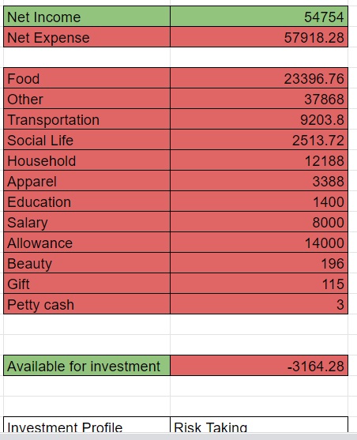
The division of fund:

Slide 5
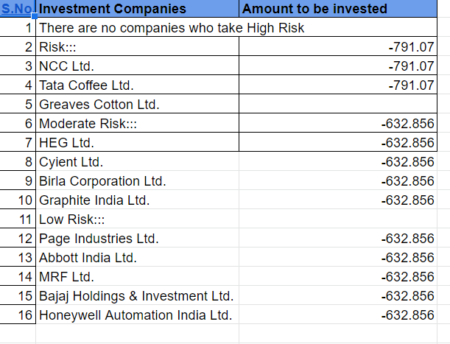
Division of fund into different company

Slide 6
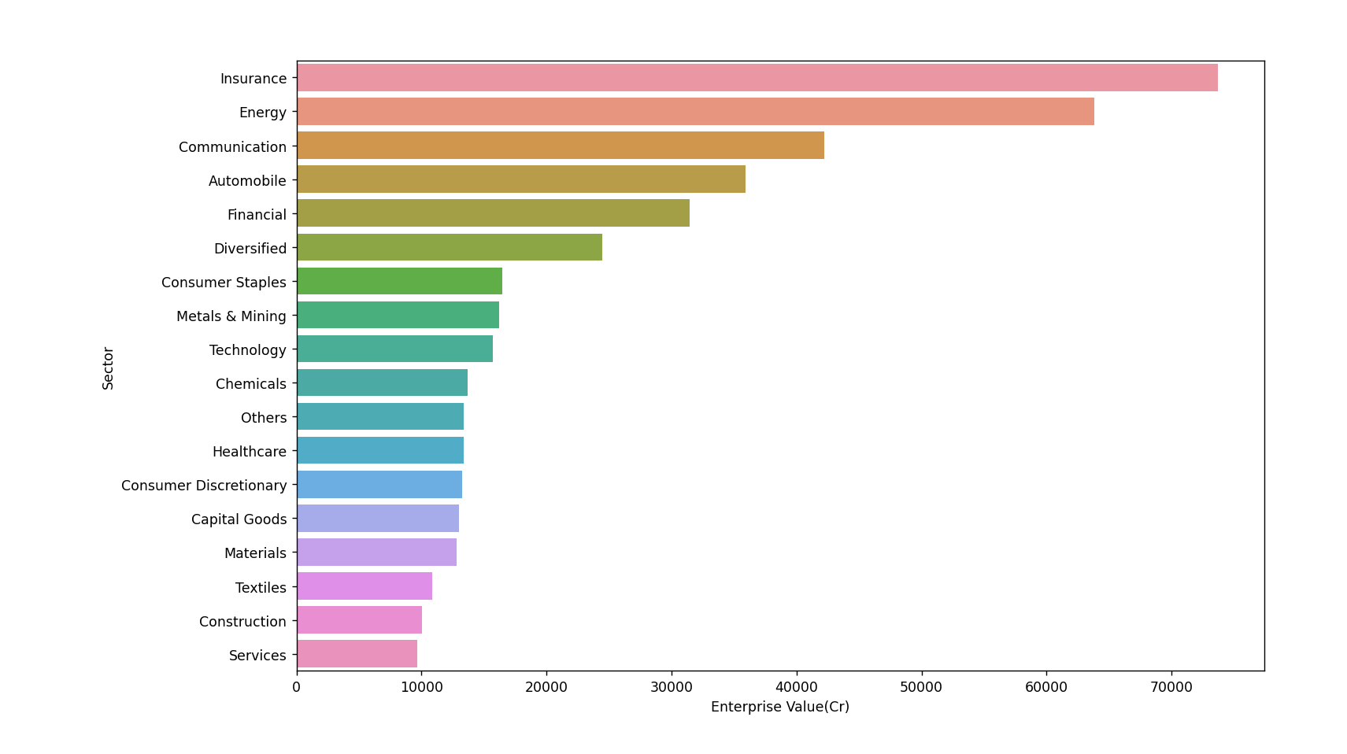
Median of different sectors to enterprise value
Out of 18 sectors insurance and energy sectors are leading the market

Slide 7
Key Performance Indicator
There are different companies in different Sectors
KPI is Key Performance Indicator
There are many KPI's than can decide the best stock in each sector like EV / EBITDA , Price to Earnings, Dividend Per Share , Price earnings to growth , Price to Book etc.
We choose our KPI as Price to Earnings
Price to Earnings = share price/earning per share
When Earning per share is more that means companies are doing a good .
So higher is earning per share, lesser will be Price to Earnings and hence
Company with least Price to Earnings will be the best stock of that sector.

Slide 8
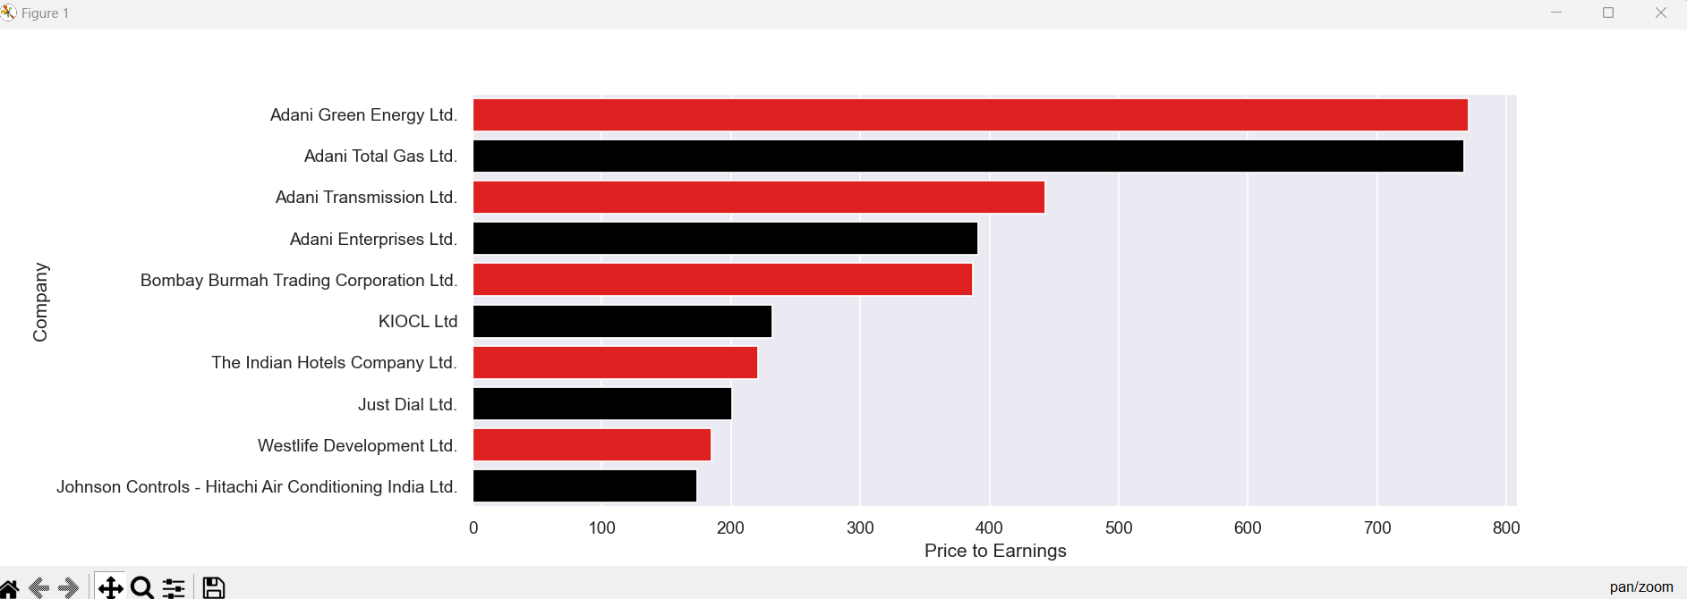
Companies according to the KPI

Slide 9
Challenges Faced
Referencing spreadsheet into our python code to make the data accessible.
API linking and google permissions & authentication.
Datatype conversion in few columns.
Visualising data using matplotlib.

Slide 10
Knowledge Acquired
Operating spreadsheets in python using Gspread.
Hands-on experience on Pandas and NumPy.
Creating graphical representations using matplotlib.
Team work management.

Slide 11
END
Thankyou !
Project built by DA-17 batch students.

